Slide 1

Selenium & SpecFlow
(with RavenDB & IIS Express)

Slide 2

@web
Feature: Display Widgets
In order to sell widgets
As a widget salesperson
I want to display widgets on my website

Slide 3
@web
Scenario: Empty list of widgets
When I view the widget list
Then the error message is “No widgets available."

Slide 4

[Binding]
public class WidgetSteps
{
[When(@”I view the widget list”)]
public void WhenIViewTheWidgetList()
{
ScenarioContext.Current.Pending();
}
}
Notes:
Access using ScenarioContext.Current.GetBindingInstance(typeof())
Show WebSteps GetWebConfiguration() method
Only one instance of each class per scenario.
Show _widgets collection on WidgetSteps class

Slide 5
[Binding]
public class WidgetSteps
{
[Then(@”the error message is “”(.*)”””)]
public void ThenTheErrorMessageIs(string expected)
{
ScenarioContext.Current.Pending();
}
}
Notes:
Explain regex stuff

Slide 6

[Binding]
public class TestRunConfiguration
{
  [BeforeTestRun]
  public static void BeforeTestRun()
  {
  }
  [AfterTestRun]
  public static void AfterTestRun()
  {
  }
}

Slide 7
[Binding]
public class WebTag
{
  [BeforeFeature("web")]
  public static void BeforeFeature()
  {
  }
  [AfterFeature("web")]
  public static void AfterFeature()
  {
  }
}

Slide 8
[Binding]
public class WebTag
{
  [BeforeScenario("web")]
  public static void BeforeScenario()
  {
  }
  [AfterScenario("web")]
  public static void AfterScenario()
  {
  }
}

Slide 9
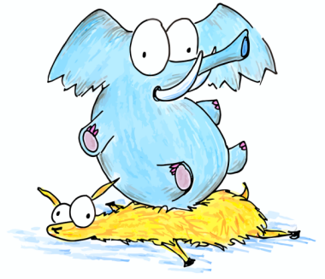
Website Environment
IIS
RavenDB
Web Browser(s)

Slide 10
Command Line Interface
Start command line process with redirected standard input / output; lets us programmatically control the application
var si = new ProcessStartInfo(exePath, arguments)
{
UseShellExecute = false,
RedirectStandardInput = true,
RedirectStandardOutput = true,
RedirectStandardError = true,
CreateNoWindow = true
};
process = new Process() { StartInfo = si };
process.Start();

Slide 11

iisexpress.exe /path:“c:\projects\website” /port:8082
Parse StdOut to get base url for tests
Says press Q to quit, but doesn’t read from StdIn, so we have to kill it.

Slide 12

Start up before each scenario
Stop after each scenario
Run in memory
Run on a specific port
Raven.Server /ram –set=Raven/Port=8081

Slide 13

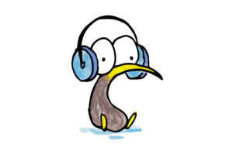
IWebDriver driver1 = new FirefoxDriver();
IWebDriver driver2 = new ChromeDriver();
IWebDriver driver3 = new SafariDriver();
IWebDriver driver4 = new InternetExplorerDriver();

Slide 14
WebSteps base class
public abstract class WebSteps
{
public IWebDriver Browser { get; }
public Uri BaseUrl { get; }
public Uri RelativeUrl();
public void NavigateTo(string url);
}

Slide 15
WebSteps
Browser is the selenium driver instance.
//May or may not include leading slash
NavigateTo("/widgets");
// Does not include leading slash
Assert.True(RelativeUrl(), new Uri(“widgets”));

Slide 16

MvcFormHelper
public class MvcFormHelper<TViewModel>
{
public MvcFormHelper(IWebDriver driver);
public TProperty Get(expression);
public void Set(expression, value);
public void Submit(expression)
public string FindElementName(expression);
public string FindElementId(expression);
public IWebElement FindElement(expression);
}

Slide 17
MvcFormHelper
Filling out a form:
var form = new MvcFormHelper<WidgetDetails>(Browser);
form.Set(m => m.Name, widget.Name);
form.Set(m => m.Size, widget.Size);
form.Submit(m => m.Name); //Any field of this form

Slide 18
MvcFormHelper
<span id=“Name”>Jason</span>
Checking displayed values
var widget = _widgets.Single();
var form = new MvcFormHelper<WidgetDetails>(Browser);
form.Get(m => m.Name).Should().Be.EqualTo(widget.Name);

Slide 19
MvcFormHelper Get magic
Works with @Html.DisplayFor(m => m.Name);
Uses MVC’s DisplayTemplates to wrap values in <span id=“x”> tags
Name the file String.cshtml; due to an MVC quirk, it’s used by non-strings also.
@model must be object since it’s used by non-strings.
@model object
<span id="@Html.IdFor(m => m)">@Model</span>

Slide 20
Cartoons licensed under Creative Commons
http://www.bluebison.net/content/terms-of-use/

